Slide 1

The Value of Read-Aloud
Benchmark Component
Notes:
Why is the Read Aloud important?
Reading aloud to students is one of the best ways to engage them with the text. Students of all ages
love to be read to, and as teachers read stories, poems, and informational texts to their students,
they model the joy of reading and the range of genres and text types students will encounter in their
own reading.
Talk about the WHY and then examples on the how and ways to do it successfully

Slide 2
Purpose of Read-Aloud
“Vision without action is a daydream; action without vision is a nightmare.” -Ancient Proverb
We must have an objective point in every lesson
Interactive read-alouds serve the added purpose of providing teachers with opportunities to demonstrate thinking while reading a text to students.
Notes:
1 As the proverb suggests, instructional action with no clear learning purpose can be a nightmare for kids!
2. We must have an objective point in every lesson, and Benchmark read-alouds do.
Studies show: Studies show that reading aloud to preschoolers increases their vocabulary
reading aloud to kids certainly must expand their knowledge of the world
Reading aloud can also stimulate an interest in reading
It was just an effective way of fostering a positive tone in my classroom; a closeness between the children and me. I didn’t do this in place of strategy lessons or what is now referred to as close reading
These are all in ADDITION to having a strategy in your lessons; a PURPOSE

Slide 3
Benjamin Franklin’s Big Splash
Read aloud
What grade would this be appropriate for?

Slide 4
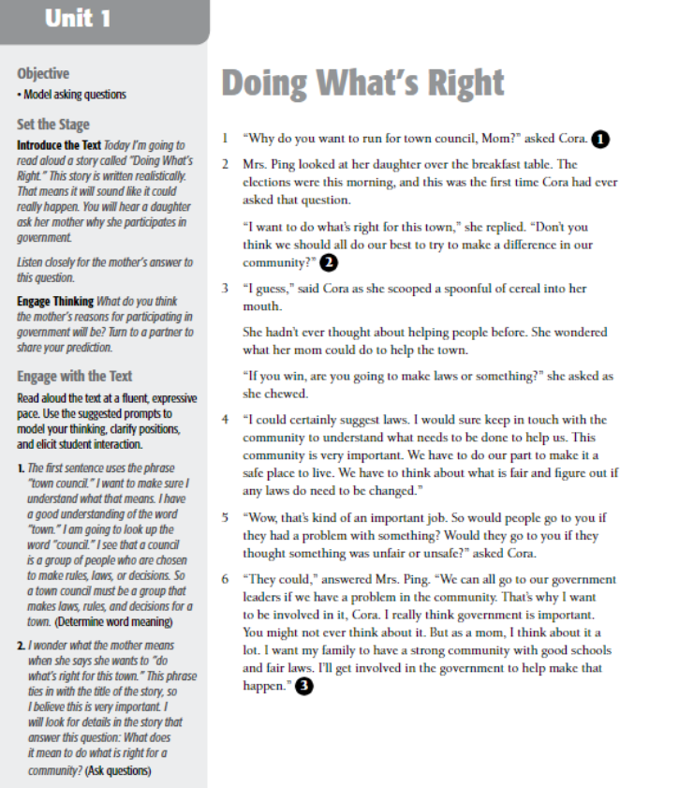
The objective is clearly written
Each number on the side corresponds to the spot in the text to stop and Model Asking Questions
Notes:
Grade 3 Uuit 1 Why Do People participate in the Government
The objective is the Metacognitive strategy we are working on in each RA
Simply laid out for you to prepare and facilitate your lesson

Slide 5
Metacognitive Strategy
•Metacognition literally means "big thinking." You are thinking about thinking. During this process you are examining your brain's processing. Teachers work to guide students to become more strategic thinkers by helping them understand the way they are processing information. Questioning, visualizing, and synthesizing information are all ways that readers can examine their thinking process. Through scaffolding and reciprocal teaching, students are able to practice the skills that lead to these overt acts becoming automatic. — Fountas and Pinnell, 2000
Notes:
Take a minute to read the slide
What stands out to me is “thinking about thinking”
Metacognitive strategies support readers to develop and deepen their comprehension of a text
before, during, and after they read. Through the application of metacognitive strategies in the
classroom, students think about thinking and develop as readers.
Modeling the Metacognitive Strategies
As you use the Read-Aloud Handbook
,
you can guide instruction with the following model
prompts.
Introduce the Passage
Read the title, share information about the author, invite students to share their ideas on what the
passage is about, and engage students with additional information.
Explain the Strategy
Each unit’s selections reinforce a specific metacognitive strategy. Explain to students that as you
read, you will model the strategy. At least one of the interactive read-aloud prompts per selection
supports the metacognitive strategy.
Read and Think Aloud
Read aloud the text with fluent expression. As you read, stop occasionally to think aloud and model
the target metacognitive strategy. Use the sample prompts during reading to help you formulate
think-alouds for the passages you are reading.
You may wish to write thoughts on self-stick notes and place the notes on the page as students
watch. In order to keep students engaged, the Read-Aloud Handbook provides four think-alouds
during the reading. More frequent interruptions may lead to confusion.
After Reading
You may ask questions to focus conversation on the habits of readers. For example:
• What did you see me do as I read the passage?
• What kinds of questions did you see me ask?
• What kinds of inferences did I make?
• Where did I find the important information?
• How did I summarize and synthesize information as I read? How did that help me?
• What information in the text helped me visualize?
• What did I do to “fix up” my comprehension?
Create a class Metacognitive Strategies Anchor Chart based on the information generated during
your discussions in each unit. Save this anchor chart and add to it each day as you continue to
focus on the same strategy.
Turn and Talk.
Invite students to share examples of metacognitive strategies they used as they
listened to the text. Ask partners to share their ideas with the whole group.
Connect and Transfer.
Remind students that readers need to be active and engaged with the text
whenever they read, and that you would like them to consciously practice using this strategy until it
feels natural and automatic.

Slide 6
Supporting Standards
Read- Aloud is another opportunity to meet standards around each topic
  Support Foundational Skills
  Enhance their Speaking and Listening Skills
  Using text evidence
Notes:
The read-aloud selections and instruction in this handbook support a range of Common Core
Standards. Teachers support students’ foundational reading skills as they model reading prose
and poetry with accuracy, appropriate rate, and expression. As students listen with purpose and
understanding, paraphrase the texts, and discuss ideas with peers, they enhance their speaking and
listening skills. The interactive read-aloud prompts also support students’ ability to use text evidence
to answer a range of text-dependent questions.

Slide 7
Resources
Teachingbooks.net
Read Aloud Handbook
Library: Recommended trade books

Slide 8

Notes:
The handbook provides read-alouds for each of the 10 units in Benchmark Advance, for each grade level. You
may use the read-alouds any time throughout the day. Think of them as a resource to draw from to
extend content knowledge beyond the selections in the Texts for Close Reading units.

Slide 9

Notes:
Do you have a favorite read-aloud? Please may use it! Remember the Read-Aloud is open for you to choose. As long as it matches the topic you are teaching... and you focus on the Metacognitive strategy being taught in that week
You can even mimic the questions shown within the Read-aloud Handbook for reference.

Slide 10
Some may ask...
"There aren’t any pictures, so how can this be interesting?”
“Why are we only given part of the chapter book or a piece of the story?”
Notes:
After learning more about the value, purpose and layout of Benchmark’s read aloud, think how you would answer these FAQ?
Thinking back to the purpose...Remember the read aloud time is used to teach a metacognitive strategy. There may still be time in you day for a read aloud with pictures or even an entire chapter book. However, it isn't necessary in order to meet the objective of these lessons.

Slide 11

Shanahan on Literacy
"Reading Aloud to Kids
and
Why Lessons Need Purposes"
https://shanahanonliteracy.com/blog/reading-aloud-to-kids-and-why-lessons-need-purposes
Notes:
For added insight from one of the world's premier literacy educators.

Slide 12
Time to Plan
Choose one book out of your grade level bucket for the unit you plan to teach after break.
Explore given resources
Do a quick plan

Slide 13
Questions or Feedback
Generate ideas for next Professional Development
Any questions?

